Slide 1
Marine Ecosystems
Created with AI Presentation Generator

Slide 2
Introduction
The ocean is home to a vast array of diverse and complex ecosystems that support a wide range of marine life. From the shallowest tide pools to the deepest ocean trenches, the ocean's ecosystems are influenced by factors such as temperature, salinity, and ocean currents. This presentation will explore the fascinating world of ocean life.

Slide 3

Marine Ecosystems
Coral Reefs
Kelp Forests
Estuaries
Deep-Sea Trenches
Arctic Seas
Upwelling Zones

Slide 4
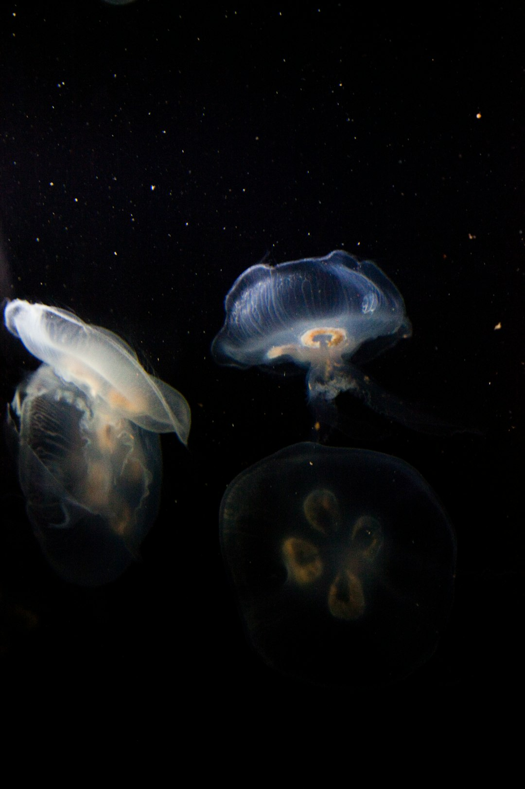
Ocean Creatures
Mammals
Fish
Invertebrates
Reptiles
Amphibians
Marine Birds

Slide 5

Biodiversity Hotspots
Great Barrier Reef
Red Sea
Mediterranean Sea
Tropical Pacific
Antarctic Ocean
Arctic Ocean

Slide 6
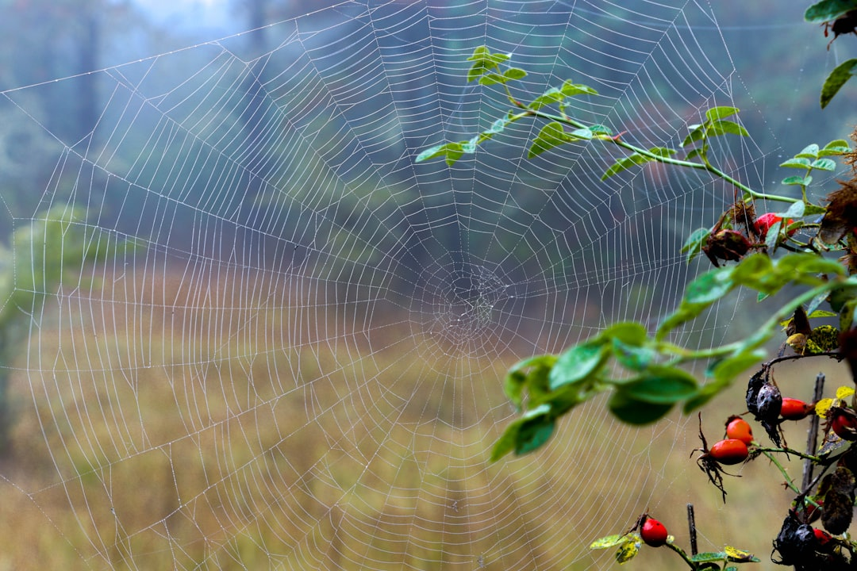
Ocean Food Webs
Phytoplankton
Zooplankton
Primary Consumers
Secondary Consumers
Tertiary Consumers
Apex Predators

Slide 7
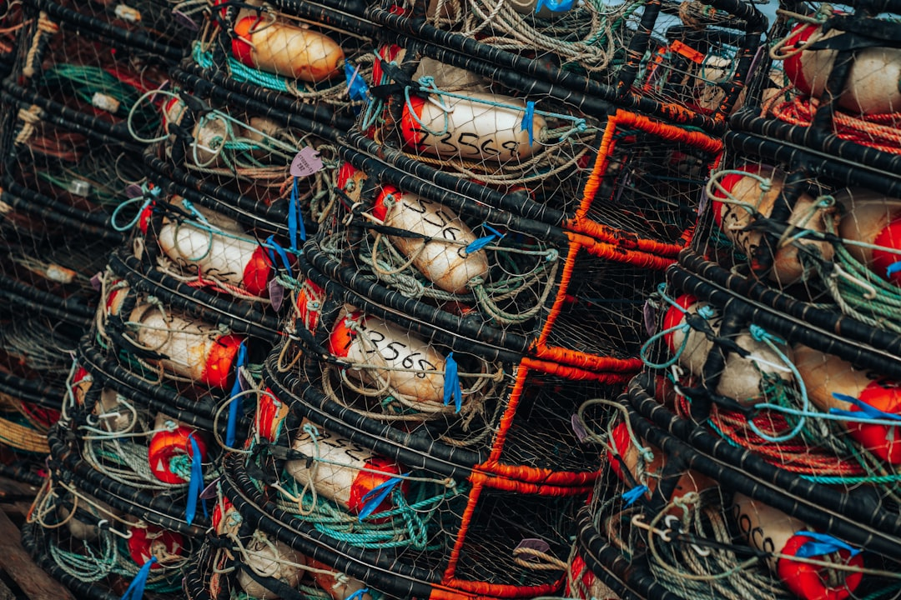
Human Impact
Overfishing
Pollution
Climate Change
Coastal Development
Ocean Acidification
Plastic Pollution

Slide 8
Conservation Efforts
Marine Protected Areas
Sustainable Fishing
Climate Change Mitigation
Waste Reduction
Education and Awareness
Research and Monitoring

Slide 9
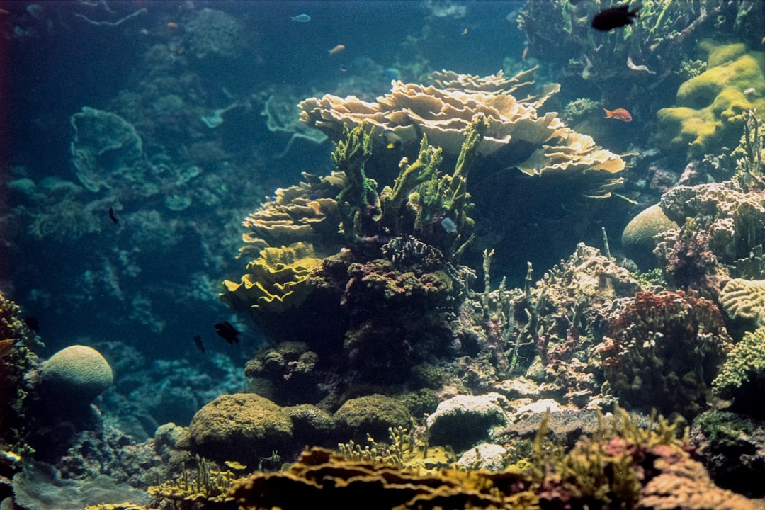
Importance of Ocean Life
Oxygen Production
Carbon Sequestration
Food Security
Coastal Protection
Economic Benefits
Recreational Opportunities

Slide 10
Challenges and Threats
Habitat Destruction
Overexploitation
Climate Change
Pollution
Invasive Species
Disease Outbreaks

Slide 11
Future Directions
Sustainable Development
Innovative Technologies
International Cooperation
Education and Awareness
Research and Development
Policy and Regulation

Slide 12
Conclusion
The ocean is a complex and vital component of our planet, supporting a wide range of marine life and ecosystems. Understanding the importance of ocean life is crucial for addressing the many challenges and threats it faces, and for ensuring the long-term health and sustainability of our ocean ecosystems.

Slide 13
Thank You!
Questions & Discussion

